Slide 1
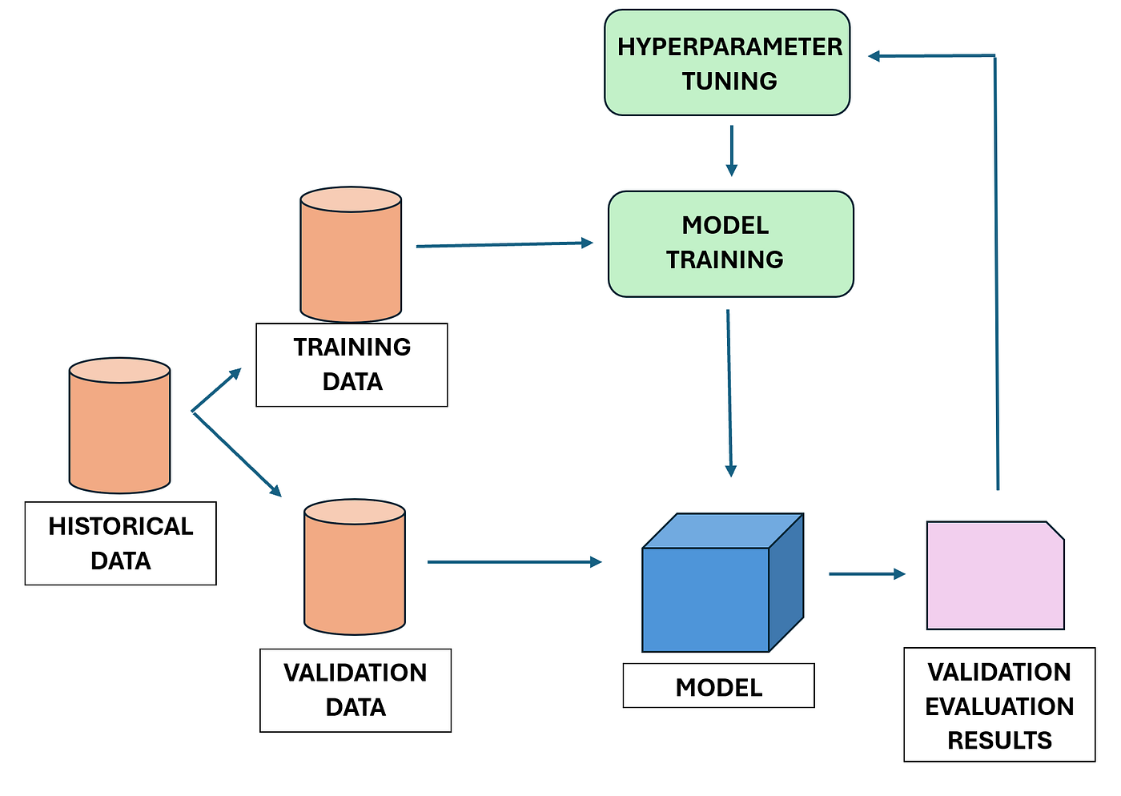
Improving the Model (Hyperparameter Tuning)
Turning the Dials for Peak Performance
Instructor: Zaryab Ahmad Khan

Slide 2
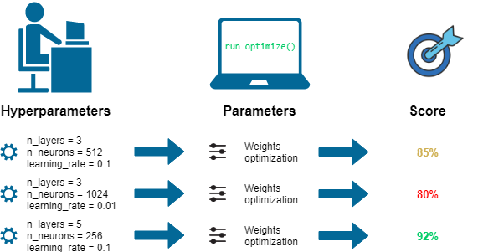
What are Hyperparameters?
The Concept: These are the "settings dials" on an algorithm.
The Difference: Unlike regular "parameters" (which the AI learns on its own), "hyperparameters" are the rules you set before training starts.
Example: Telling a Random Forest exactly how many trees to build (e.g., 50 vs. 500).

Slide 3
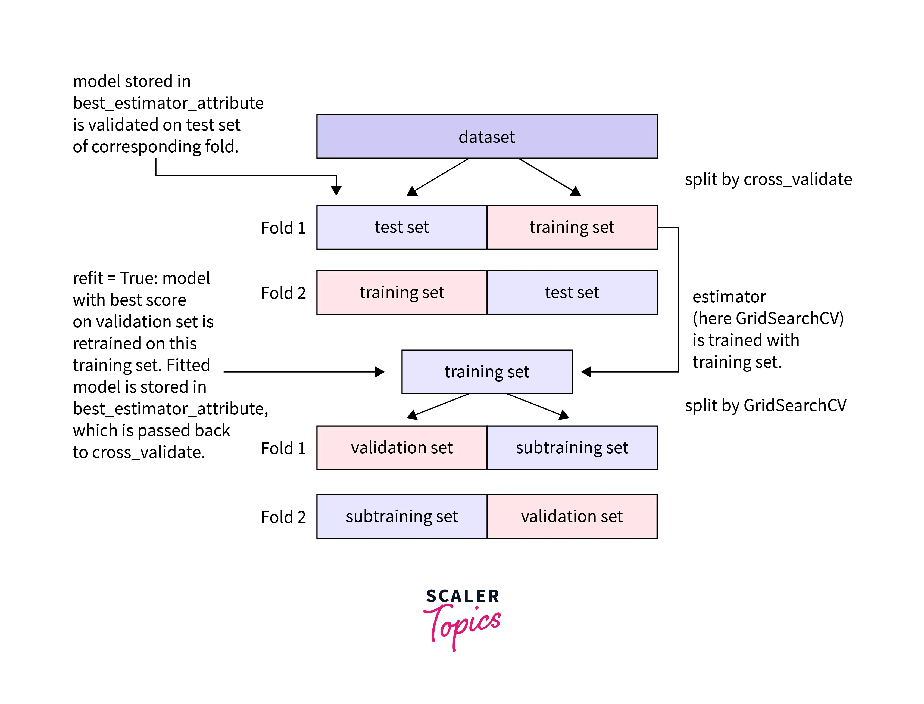
Grid Search (GridSearchCV)
The Problem: How do you know if 100 trees or 200 trees is better? Testing one by one is slow.
The Solution: Grid Search.
Process: You give the computer a list of different settings, and it forces the AI to test every single possible combination to find the most accurate setup.

Slide 4
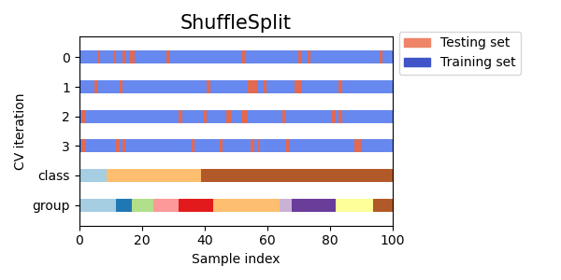
Cross-Validation (CV)
The Goal: Reliability.
The Method: Instead of testing the model just once, we slice the data into 5 different parts (5-fold CV).
The Benefit: The model is tested 5 different times on different slices of the data. If it performs well on all of them, you know your results are reliable and not just a "lucky" split.

